Slide 1
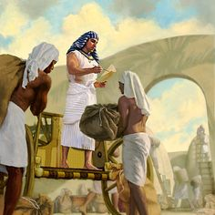
‘Joseph the Dreamer’
META-MORPHOSIS JUVENILE REHABILITATION PROGRAM ™
A young man thrown into prison for 13 years and surfaced Governor of Egypt.
A story of attitude and forgiveness.
Class 4
Notes:
Narration: Bible Study 4

Slide 2
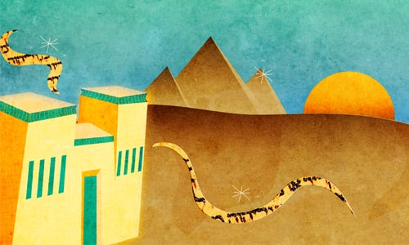
“From a Dreamer to Governor”
Notes:
Narrative:

Slide 3
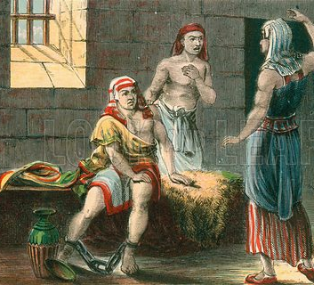
Pharaoh’s chief butler and baker were placed in custody with Joseph
Notes:
Narrative:
Text Genesis 40: 1- 23
The Prisoners’ Dreams It came to pass after these things that the butler and the baker of the king of Egypt offended their lord, the king of Egypt. And Pharaoh was angry with his two officers, the chief butler and the chief baker. So he put them in custody in the house of the captain of the guard, in the prison, the place where Joseph was confined. And the captain of the guard charged Joseph with them, and he served them; so they were in custody for a while.

Slide 4
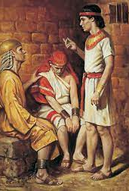
The baker and butler have troubling dreams
Notes:
Narrative
Then the butler and the baker of the king of Egypt, who were confined in the prison, had a dream, both of them, each man’s dream in one night and each man’s dream with its own interpretation. And Joseph came in to them in the morning and looked at them, and saw that they were sad. So he asked Pharaoh’s officers who were with him in the custody of his lord’s house, saying, “Why do you look so sad today?” And they said to him, “We each have had a dream, and there is no interpreter of it.”

Slide 5
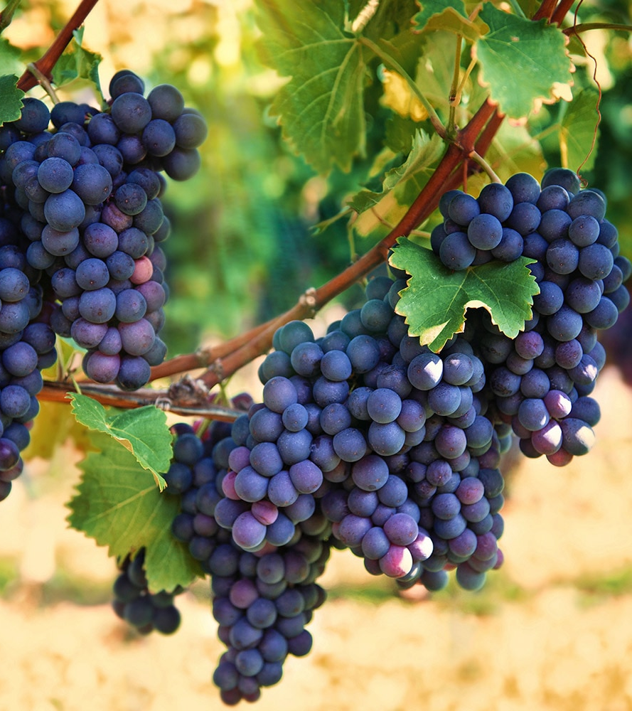
Joseph interprets the butler’s dream & in return asks that he talks to Pharaoh for him
Notes:
Narrative
So Joseph said to them, “Do not interpretations belong to God? Tell them to me, please.” Then the chief butler told his dream to Joseph, and said to him, “Behold, in my dream a vine was before me, and in the vine were three branches; it was as though it budded, its blossoms shot forth, aThnd its clusters brought forth ripe grapes. Then Pharaoh’s cup was in my hand; and I took the grapes and pressed them into Pharaoh’s cup, and placed the cup in Pharaoh’s hand.” And Joseph said to him, “This is the interpretation of it: The three branches are three days. Now within three days Pharaoh will lift up your head and restore you to your place, and you will put Pharaoh’s cup in his hand according to the former manner, when you were his butler.
But remember me when it is well with you, and please show kindness to me; make mention of me to Pharaoh, and get me out of this house. For indeed I was stolen away from the land of the Hebrews; and also I have done nothing here that they should put me into the dungeon.”

Slide 6
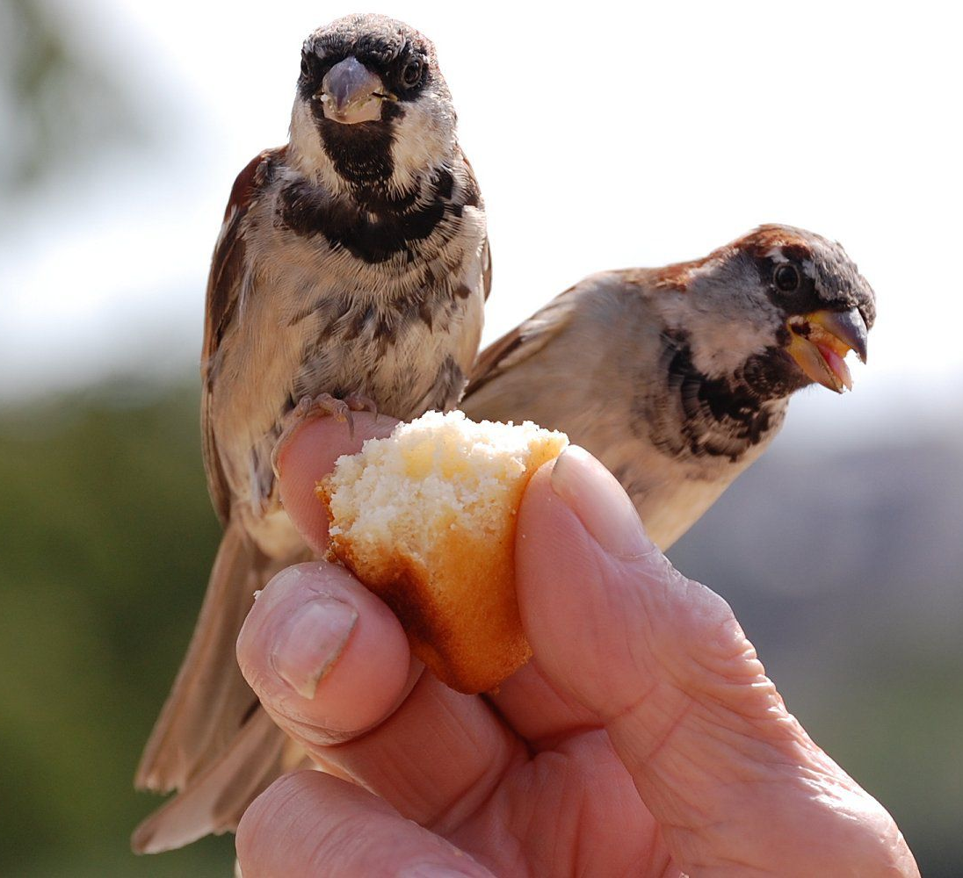
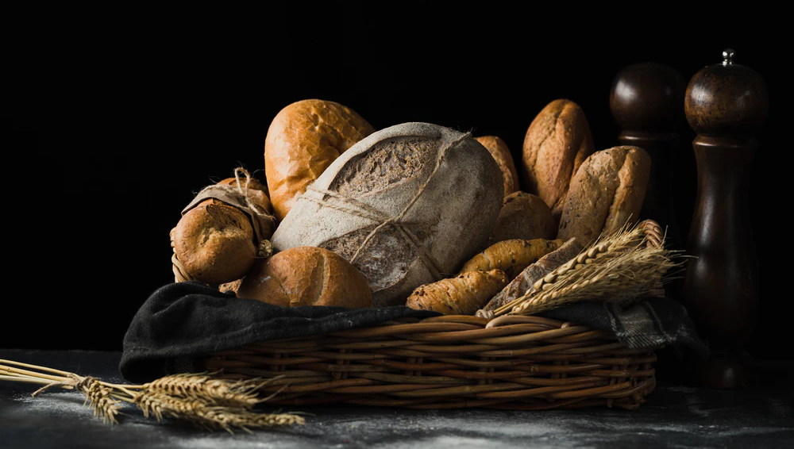
Joseph interprets the baker’s dream
Notes:
Narrative
When the chief baker saw that the interpretation was good, he said to Joseph, “I also was in my dream and there were three white baskets on my head. In the uppermost basket were all kinds of baked goods for Pharaoh, and the birds ate them out of the basket on my head.” So Joseph answered and said, “This is the interpretation of it: The three baskets are three days. Within three days Pharaoh will lift off your head from you and hang you on a tree; and the birds will eat your flesh from you.”

Slide 7
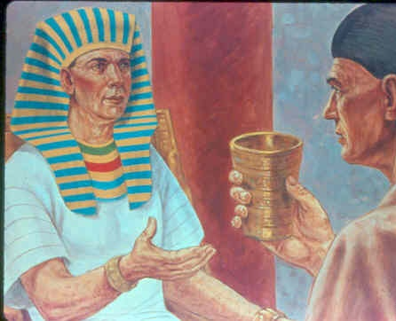
Both of Joseph’s dream interpretations came true
Notes:
Narrative
Now it came to pass on the third day, which was Pharaoh’s birthday that he made a feast for all his servants; and he lifted up the head of the chief butler and of the chief baker among his servants. Then he restored the chief butler to his butlership again, and he placed the cup in Pharaoh’s hand. But he hanged the chief baker, as Joseph had interpreted to them. Yet the chief butler did not remember Joseph, but forgot him.

Slide 8
Group Discussion
1. From childhood God spoke to Joseph in dreams, why do you think God did that?
2. Does God work the same way with all people?
3. Have you ever had a dream that stood out in your life?
4. God wants us to look to Him for everything, what did Joseph do to show that he still wasn’t ready for great things in his life? (Asked the butler for help) He was still looking to man
5. Why is it so important for God to be your complete source for everything?(If you look to man, it interferes with your faith)
6. Think about some things in your life that you need to trust God for?
7. What can you do to show God you are looking to him, or do you think He knows already?
8. What is the difference in operating in faith or operating in the flesh. What does that mean?
9. What do you think is going to happen to Joseph because he asked the butler for help?
Notes:
Narrative Group Discussion
Break into groups of 4 and discuss the following questions.
Please Note:
Only give them one question at a time, after they have had adequate time to discuss, move to the next question.
1. From childhood God spoke to Joseph in dreams, why do you think God did that?
2. Does God work the same way with all people?
3. Have you ever had a dream that stood out in your life?
4. God wants us to look to Him for everything, what did Joseph do to show that he still wasn’t ready for great things in his life? (Asked the butler for help) He was still looking to man
5. Why is it so important for God to be your complete source for everything?
(If you look to man, it interferes with your faith)
Think about some things in your life that you need to trust God for?
What can you do to show God you are looking to him, or do you think He knows already?
What is the difference in operating in faith or operating in the flesh. What does that mean?
What do you think is going to happen to Joseph because he asked the butler for help?
Come back to a whole group and re-ask the same questions and see if anyone wants to share their thoughts.

Slide 9
References
https://w2.chabad.org/media/images/994/UoNg9948724.jpg?_i=_n32DD4A5CE5B405756B86D11830CBE5B1
https://media.istockphoto.com/photos/jail-cell-picture-id502846348?k=6&m=502846348&s=612x612&w=0&h=rhL5-ze1NqTp7DK7oUqzrOlxI-okK19X76GCm_0OkeA=
https://i.pinimg.com/236x/a2/5f/65/a25f657d6a17f31e47e677c39abd26e0--free-bible-bible-pictures.jpg
https://www.lookandlearn.com/history-images/preview/M/M847/M847238_Joseph-interpreting-the-dreams-of-the-Chief-Butler-and-Baker-in-prison.jpg
https://www.google.com/url?sa=i&url=https%3A%2F%2Fwww.churchofjesuschrist.org%2Fmedia%2Fimage%2Fjoseph-egypt-interprets-dreams-parson-02de834%3Flang%3Deng&psig=AOvVaw1c0z8D1SQTmYEKvYL6ePTQ&ust=1623980964939000&source=images&cd=vfe&ved=0CAIQjRxqFwoTCPirut3GnfECFQAAAAAdAAAAABAR
https://contentgrid.thdstatic.com/hdus/en_US/DTCCOMNEW/Articles/how-to-grow-grapes-hero.jpg
https://st-takla.org/Gallery/var/albums/Bible/Illustrations/Bible-Slides/OT/01-Genesis/www-St-Takla-org--Bible-Slides-genesis-231.jpg
https://www.thespruce.com/thmb/iDIY3ZKK7FtGL0zzSp-A6CN81Kw=/1500x1000/filters:no_upscale():max_bytes(150000):strip_icc()/feeding-bread-5a1c628f13f12900381302d3.jpg
https://images.unsplash.com/photo-1566698629409-787a68fc5724?ixlib=rb-1.2.1&ixid=MnwxMjA3fDB8MHxwaG90by1wYWdlfHx8fGVufDB8fHx8&auto=format&fit=crop&w=1000&q=80

Slide 10
Original Narrative
Notes:
“FROM A DREAMER TO GOVENOR”
Text Genesis 40: 1- 23
The Prisoners’ Dreams It came to pass after these things that the butler and the baker of the king of Egypt offended their lord, the king of Egypt. And Pharaoh was angry with his two officers, the chief butler and the chief baker. So he put them in custody in the house of the captain of the guard, in the prison, the place where Joseph was confined. And the captain of the guard charged Joseph with them, and he served them; so they were in custody for a while.
Then the butler and the baker of the king of Egypt, who were confined in the prison, had a dream, both of them, each man’s dream in one night and each man’s dream with its own interpretation. And Joseph came in to them in the morning and looked at them, and saw that they were sad. So he asked Pharaoh’s officers who were with him in the custody of his lord’s house, saying, “Why do you look so sad today?” And they said to him, “We each have had a dream, and there is no interpreter of it.”
So Joseph said to them, “Do not interpretations belong to God? Tell them to me, please.” Then the chief butler told his dream to Joseph, and said to him, “Behold, in my dream a vine was before me, and in the vine were three branches; it was as though it budded, its blossoms shot forth, and its clusters brought forth ripe grapes. Then Pharaoh’s cup was in my hand; and I took the grapes and pressed them into Pharaoh’s cup, and placed the cup in Pharaoh’s hand.” And Joseph said to him, “This is the interpretation of it: The three branches are three days. Now within three days Pharaoh will lift up your head and restore you to your place, and you will put Pharaoh’s cup in his hand according to the former manner, when you were his butler.
But remember me when it is well with you, and please show kindness to me; make mention of me to Pharaoh, and get me out of this house. For indeed I was stolen away from the land of the Hebrews; and also I have done nothing here that they should put me into the dungeon.” When the chief baker saw that the interpretation was good, he said to Joseph, “I also was in my dream and there were three white baskets on my head. In the uppermost basket were all kinds of baked goods for Pharaoh, and the birds ate them out of the basket on my head.” So Joseph answered and said, “This is the interpretation of it: The three baskets are three days. Within three days Pharaoh will lift off your head from you and hang you on a tree; and the birds will eat your flesh from you.”
Now it came to pass on the third day, which was Pharaoh’s birthday that he made a feast for all his servants; and he lifted up the head of the chief butler and of the chief baker among his servants. Then he restored the chief butler to his butlership again, and he placed the cup in Pharaoh’s hand. But he hanged the chief baker, as Joseph had interpreted to them. Yet the chief butler did not remember Joseph, but forgot him.
Study Group Questions
1. From childhood God spoke to Joseph in dreams, why do you think God did that?
2. Does God work the same way with all people?
3. Have you ever had a dream that stood out in your life?
4. God wants us to look to Him for everything, what did Joseph do to show that he still wasn’t ready for great things in his life? (Asked the butler for help) He was still looking to man
5. Why is it so important for God to be your complete source for everything?
(If you look to man, it interferes with your faith)
Think about some things in your life that you need to trust God for?
What can you do to show God you are looking to him, or do you think He knows already?
What is the difference in operating in faith or operating in the flesh. What does that mean?
What do you think is going to happen to Joseph because he asked the butler for help?

